Slide 1
Pox, Pus and Plague
Diseases in History

Slide 2

Have learned about some of the deadliest epidemic diseases in history
Will know how these diseases spread
Will have carried out a source analysis
At the end of today’s lesson…

Slide 3
What is disease?
Pathogen Disease
Bacteria ?
Viruses ?
Pathogen Disease
Fungi ?
Protozoa ?

Slide 4
What is disease?
Pathogen Disease
Bacteria Cholera / Plague / Tuberculosis
Viruses Smallpox / Measles
Pathogen Disease
Fungi Athlete’s foot
Protozoa Malaria

Slide 5
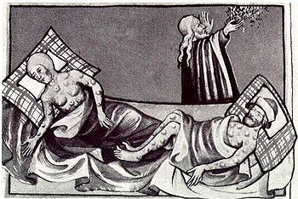
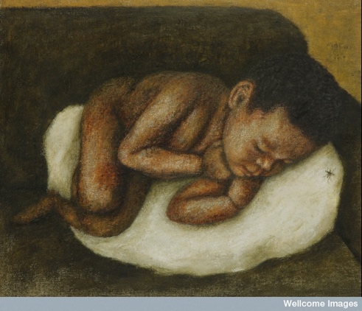
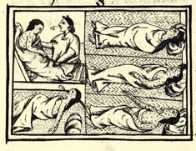
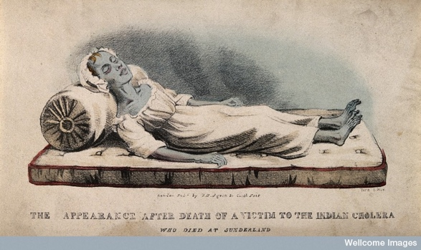
Exercise 1 – Match symptoms to the Disease
Disease
On your sheets – Match the Disease to the Symptoms
Cholera
Plague
Smallpox
Malaria

Slide 6
Exercise 1 – Match symptoms to the Disease
Disease
On your sheets – Match the Disease to the Symptoms
Cholera
Plague
Smallpox
Malaria
A
B
C
D

Slide 7
Disease Cause
Cholera Bacteria in Water / Food
Plague Bacteria spread by touch
How did people get it?
Disease Cause
Smallpox Virus spread by touch and bodily fluids
Malaria Mosquitoes

Slide 8
What is an Epidemic

Slide 9
Rapid spread
2 weeks or less
What is an Epidemic
International = Pandemic
Large number of people

Slide 10
What is the source?
When was it created?
Who created it?
Why was it created?
Using Sources
in History
Content
Context
Audience
Bias

Slide 11
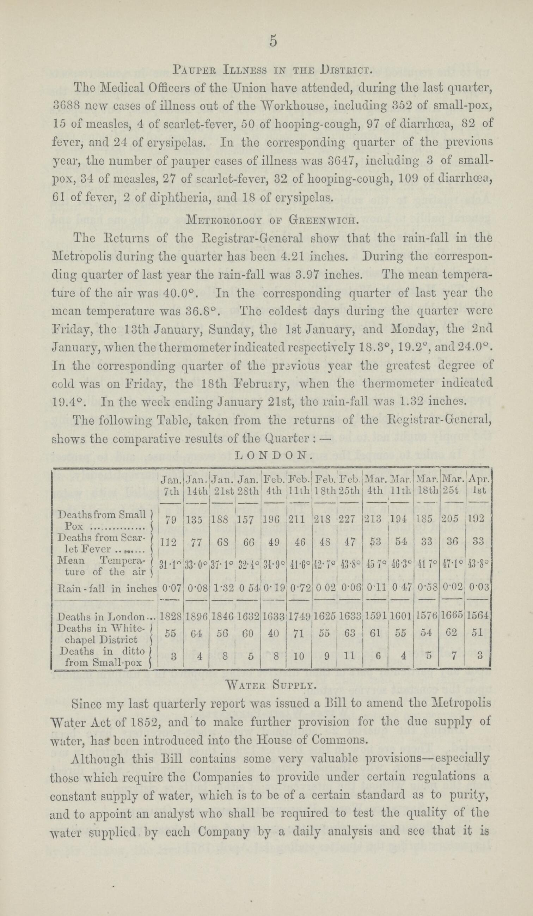
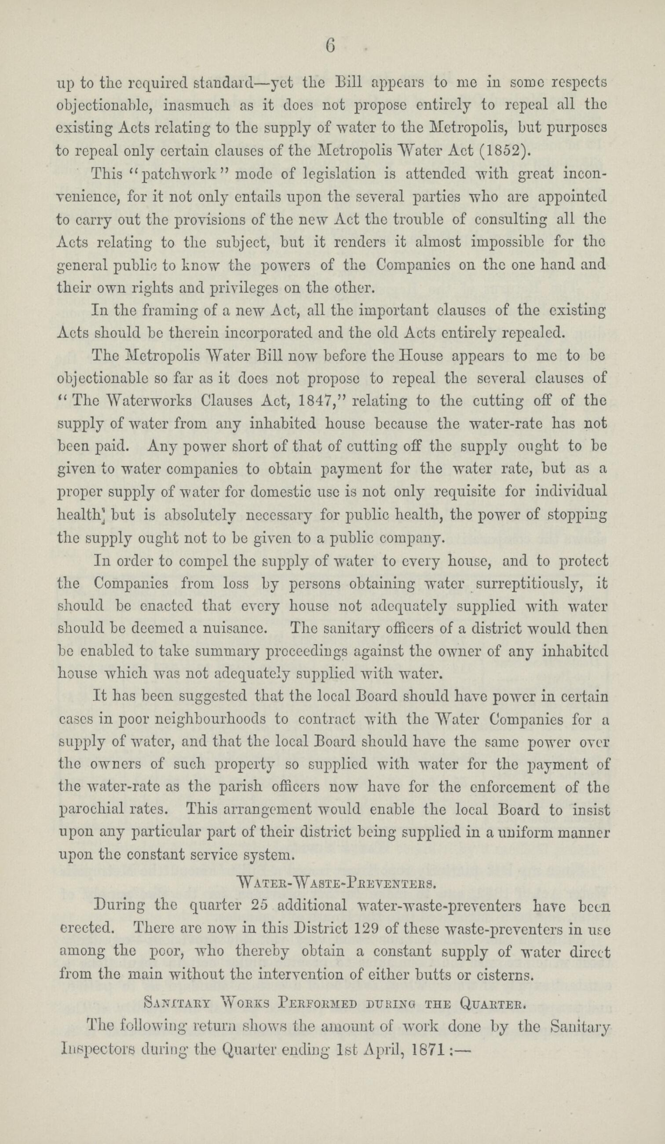
Smallpox
Epidemic –
18th century 60 million Europeans,
6 Monarchs and 95% of the new world.
Estimated up to 300 million deaths during the 20th century.
Spread by poor cleanliness and contact

Slide 12
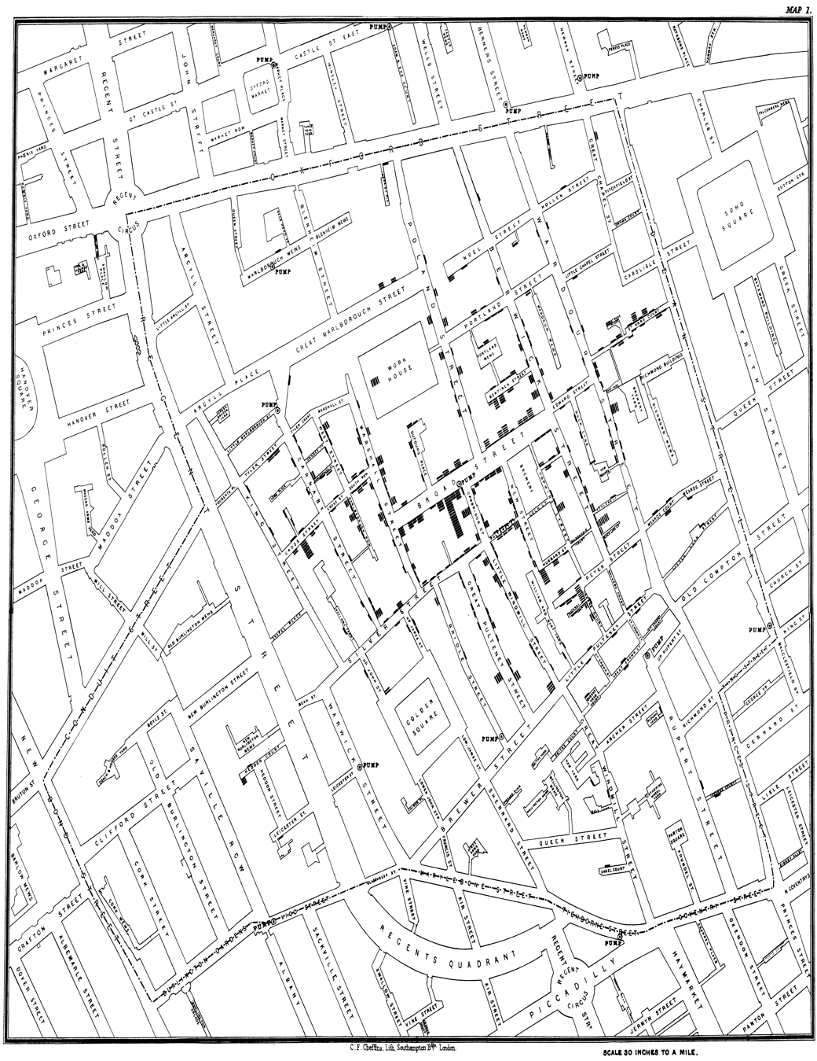
Cholera
Epidemic –
Worst outbreak killed 14,137 people in London 1848-9
1832 cholera killed 3000 in Glasgow
1.4 to 4.3 million cases per year today
Spread by poor cleanliness and contact

Slide 13
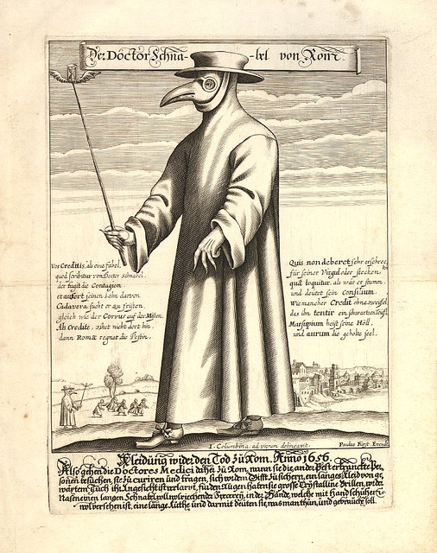
Plague
Worst Epidemic – Black Death
Black Death” caused the death of 60% of the population of Europe
1346 – 53 estimated 75 to 200 million people
Spread by mass movement of people and rats

Slide 14
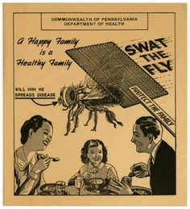
Malaria
Worst Epidemic – None
198 million malaria cases in 2013 alone
2000 cases in 2014/5 in the UK brought in through immigration
Spread by mosquitos and poor drainage

Slide 15
Exercise 2 – Source Analysis
Source
Fill out the source analysis sheets for your group’s source
Smallpox (Official Report)
Cholera (Map)
Plague (Verse)
Malaria (Poster)

Slide 16
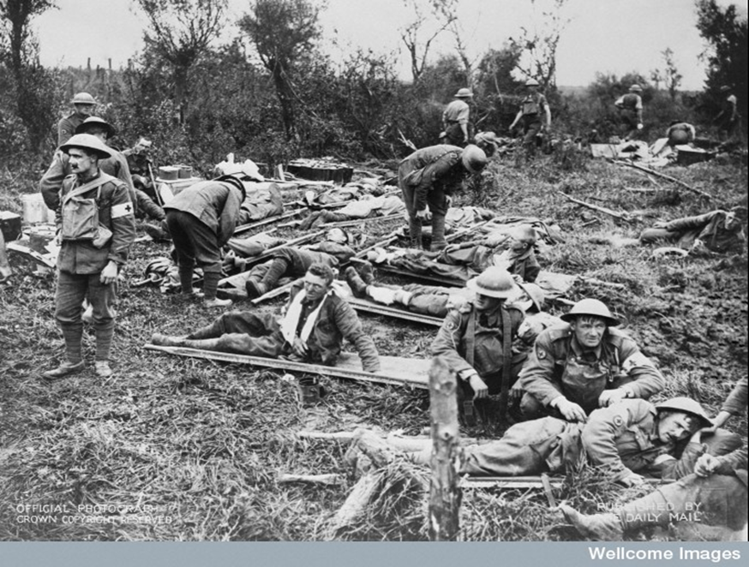
Next week –
Bombs and Bandages: Medicine and the First and Second World Wars

