Slide 1
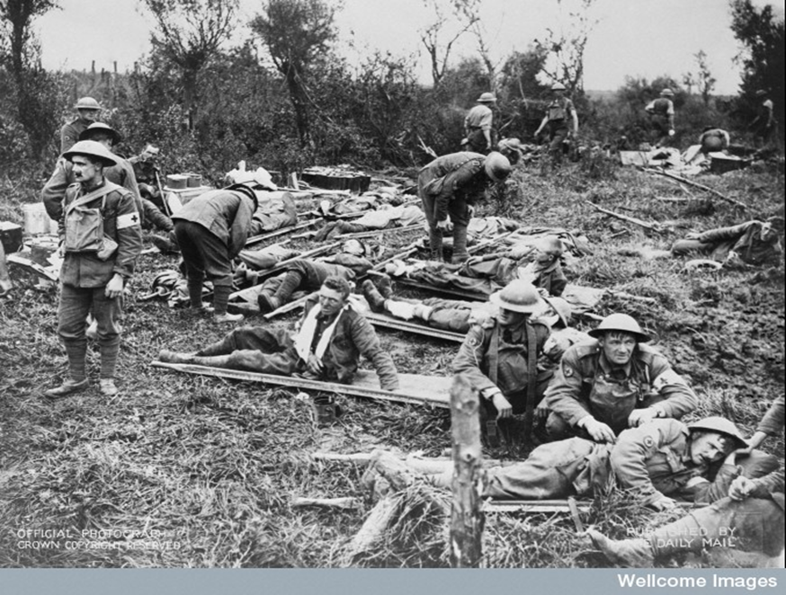
Bombs and Bandages: Medicine and the First and Second World Wars

Slide 2
By the end of today’s lesson you will:
Know about the types of wounds that soldiers were most likely to suffer from in the First and Second World Wars.
Understand how wounded soldier were treated on the battlefield and in hospitals.
Analyse a primary source related to the history of war medicine

Slide 3
Survival rates in the British Army
First World War
1,837,613 British soldiers wounded
6-10% died of wounds
Second World War
239,575 British soldiers wounded
2% died of wounds
What does this tell us?

Slide 4
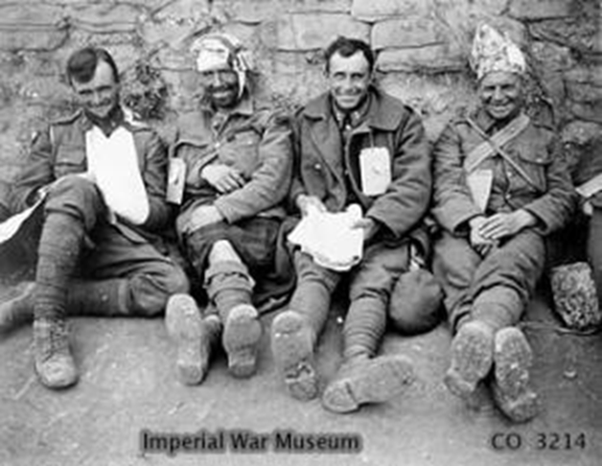
They got significantly better at saving lives!

Slide 5
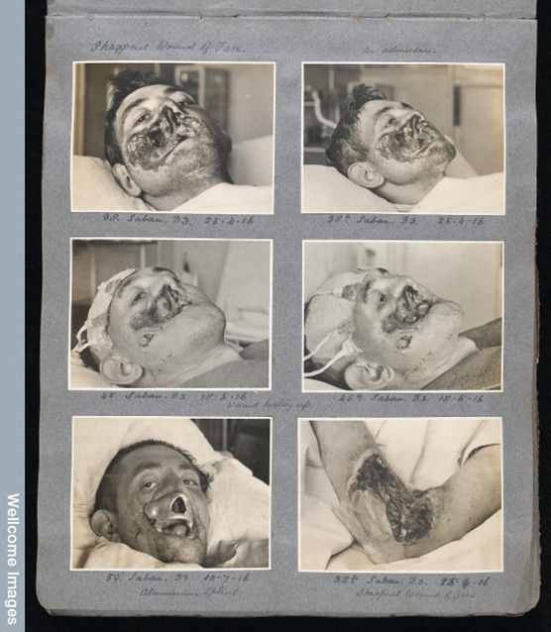
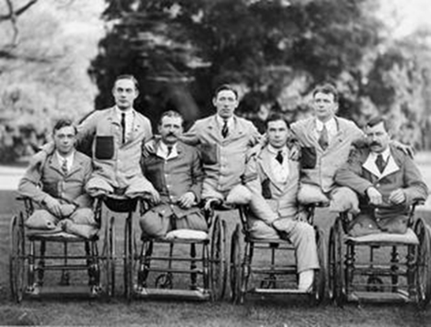
Wounds – First World War
Gunshot wounds to the face (60,500 British soldiers)
Loss of one or both eyes
Chest wounds
Amputation of arms and legs (41,000 British servicemen)

Slide 6
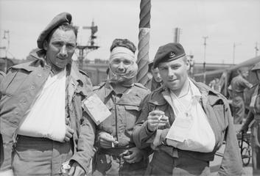
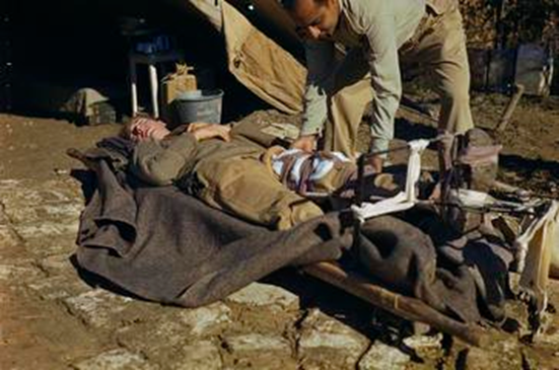
Wounds – Second World War
Multiple wounds across the body caused by mortar, grenade, aerial bomb, shell (75% all wounds)
Abdominal (stomach)wounds
Superficial wounds (shrapnel)

Slide 7
Sorting the wounded - Triage
Walking wounded
Fatal cases
Most serious wounds but with best survival chances
Activity 1: Decide who to treat first…

Slide 8
Activity 1: Decide who to treat first…
Stephen Fennel – Flesh Wound
George Fieldhouse – Face Wound
Fred Jones – Leg Wound

Slide 9
Activity 1: Decide who to treat first…
Fred Jones (High Priority)
  Serious injury but with high chances of recovery
  Treat immediately to attempt to save leg and then ship home

Slide 10
Activity 1: Decide who to treat first…
Fred Jones (High Priority)
  Serious injury but with high chances of recovery
  Treat immediately to attempt to save leg and then ship home
Stephen Fennel – (Medium Priority)
  Flesh Wound – Easy to get him back to fighting
  Treat as soon as possible and discharge

Slide 11
Activity 1: Decide who to treat first…
Fred Jones (High Priority)
  Serious injury but with high chances of recovery
  Treat immediately to attempt to save leg and then ship home
Stephen Fennel – (Medium Priority)
  Flesh Wound – Easy to get him back to fighting
  Treat as soon as possible and discharge
George Fieldhouse – (Lowest Priority)
  Potentially fatal injury regardless of treatment –
  Give pain relief and clean surface area - treat when available

Slide 12
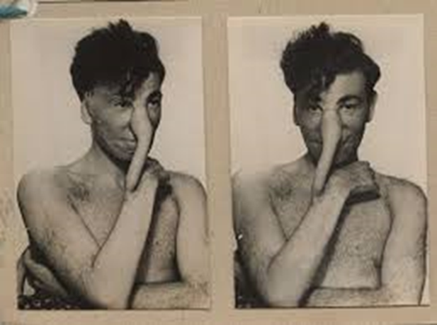
Plastic surgery
….Large areas of skin loss and missing skin were often repaired by tubes of skin, taken from the patient's abdomen or chest; these were called pedicles. Replacement noses, lost through burns, bullets or bombs could need 5 or more operations before a new nose was achieved
Excerpt taken from the presentation by Margaret Chadd MBE to Norfolk and General Hospital in 1987.
There was no such thing as plastic surgery before WW1
WW1 – Harold Gillies treated wounded soldiers at the Queens Hospital in Sidcup
WW2 – Archibald McIndoe used plastic surgery on wounded soldiers at Queen Victoria Hospital, East Grinstead
We now have plastic surgery for all types of wounds and conditions!
Primary Source Alert!

Slide 13
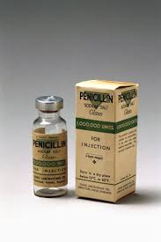
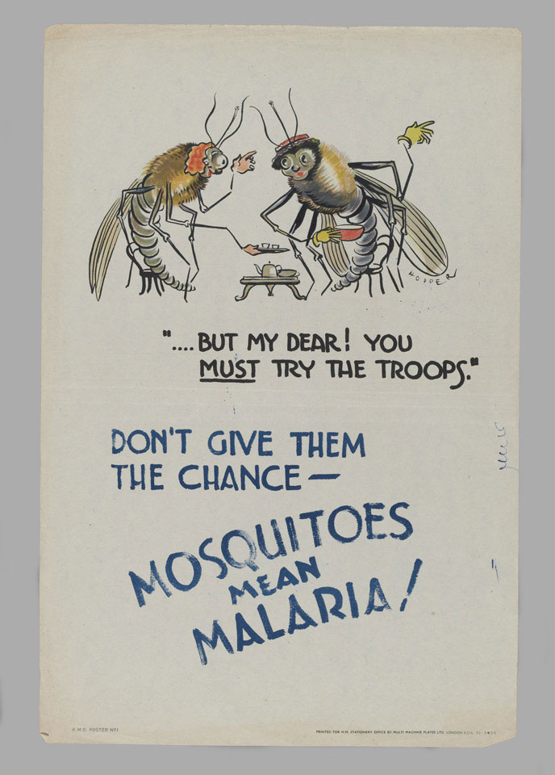
Penicillin
Before antibiotics many soldiers died because their wounds became infected
1928 – penicillin discovered by Edward Fleming
1939 – penicillin was developed by Howard Florey and Ernst Chain
1943 - used on soldier with infected wounds in North Africa
1944 – every Allied soldier had penicillin from D-Day
We use penicillin for lots of infections today!
Primary Source Alert!

Slide 14
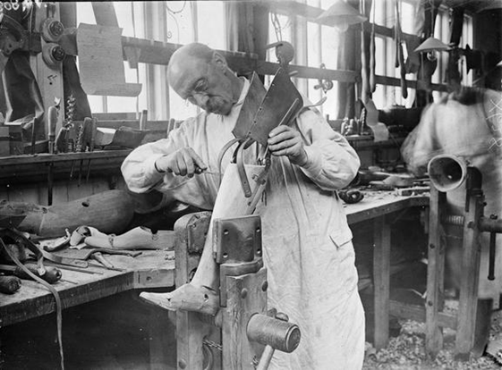
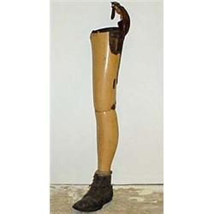
Prosthetic limbs
Before WW1 most artificial limbs were made out of wood (peg legs)
1915 - Queen Mary’s Hospital, Roehampton, 26,000 men fitted with artificial limbs – each one specially made
We now have plastic, metal and hydraulic artificial limbs!
Primary Source Alert!

Slide 15
Exercise 2 – Source Analysis
Fill out the source analysis sheets for your group’s source
Source
Malaria Warning (Poster)
Surgical Account (Written)
Leg (Object)

Slide 16
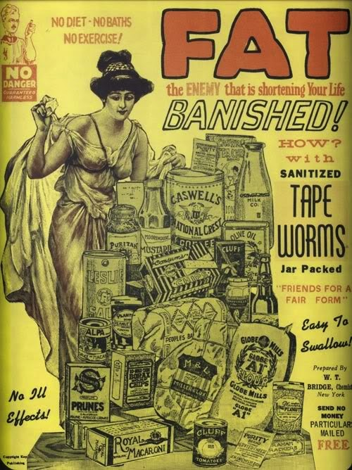
Next week –
Fad Diets – Chew-Chew Dieting in the Early Twentieth Century

